Slide 1
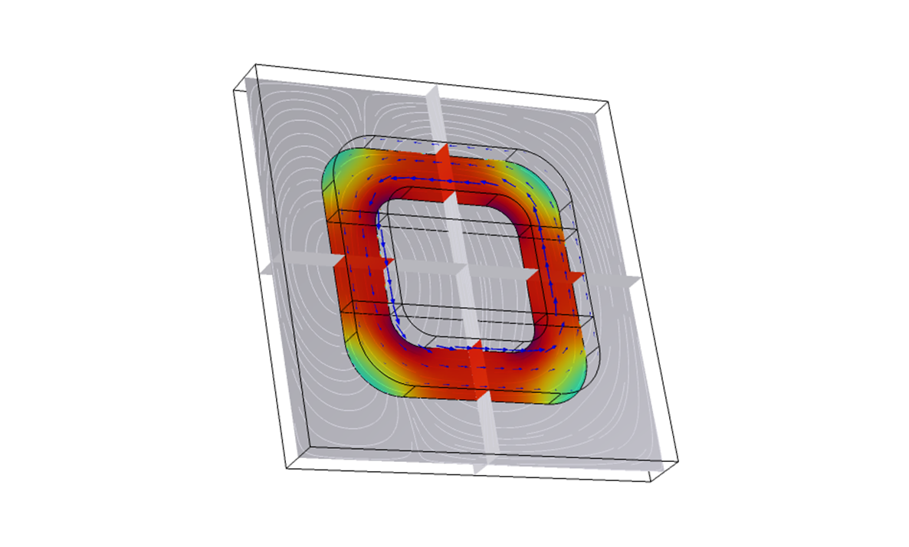
Open Circuit Step-up Transformer Modelling Using COMSOL Multiphysics
Saloni Adanna

Slide 2
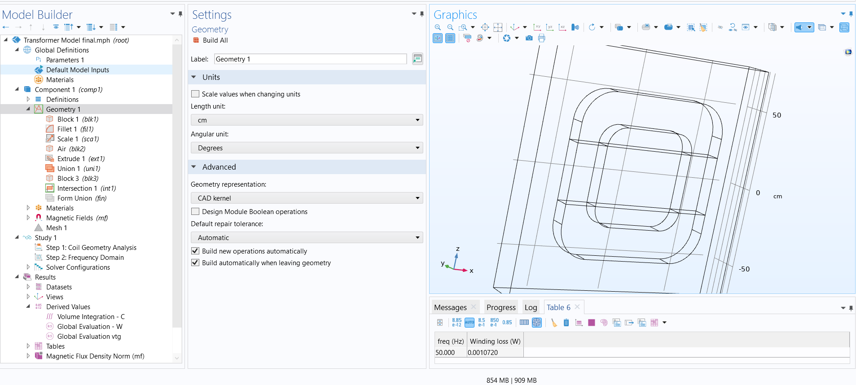
Coil Geometry

Slide 3
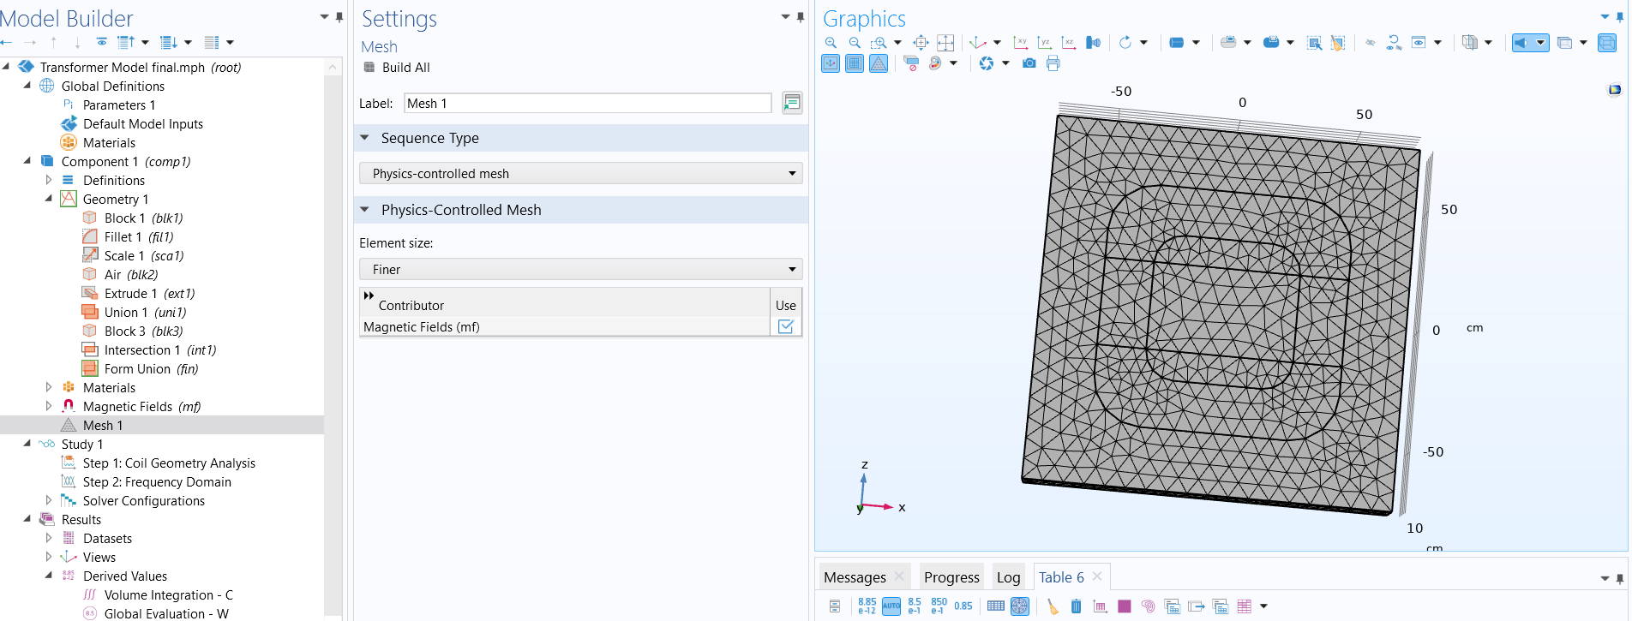
Mesh

Slide 4
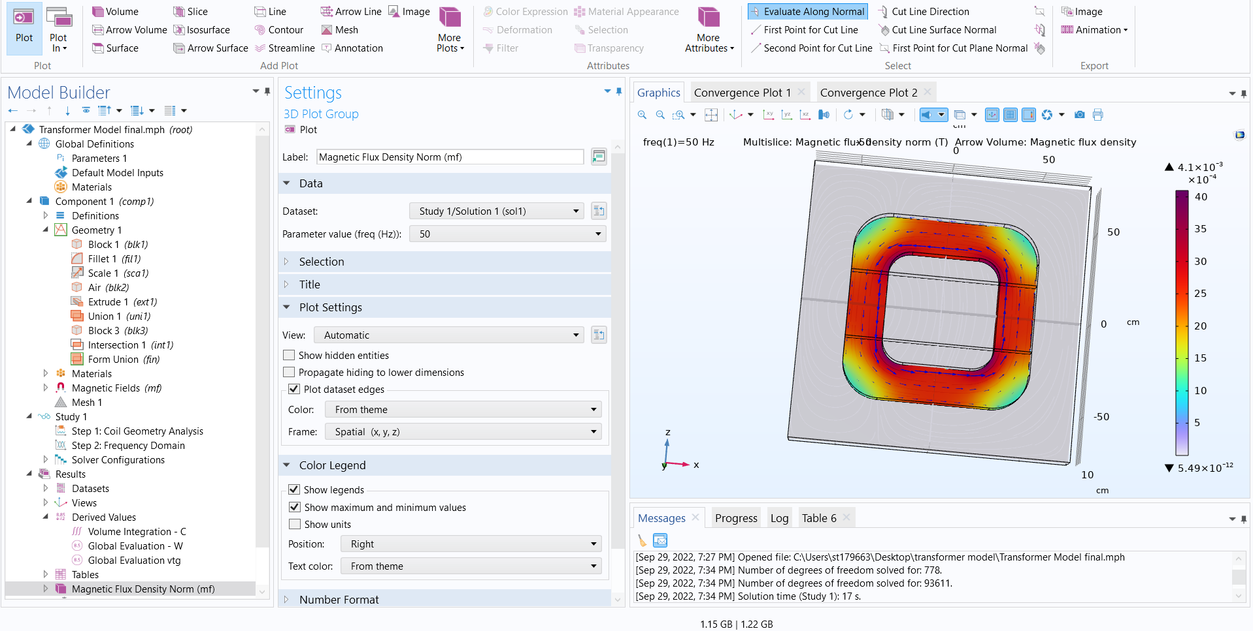
Magnetic Flux Density

Slide 5
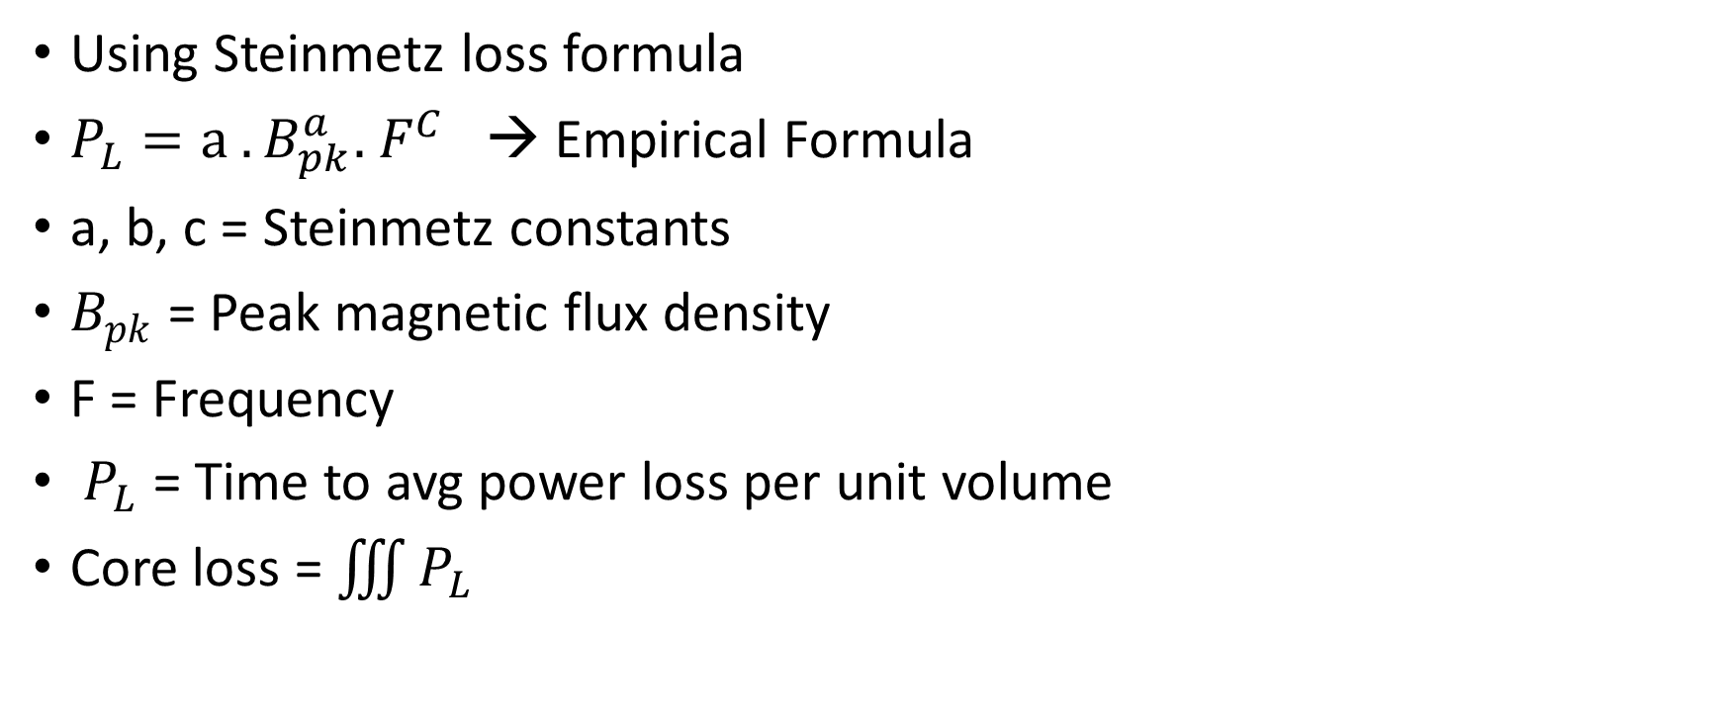
Core loss calculations -
Using Steinmetz loss formula
$P_{L}=a . B_{pk}^{a}.{ F}^{C}$ → Empirical Formula
a, b, c = Steinmetz constants
$B_{pk}$= Peak magnetic flux density
F = Frequency
$P_{L}$ = Time to avg power loss per unit volume
Core loss = $\iiint{P_{L}}$

Slide 6
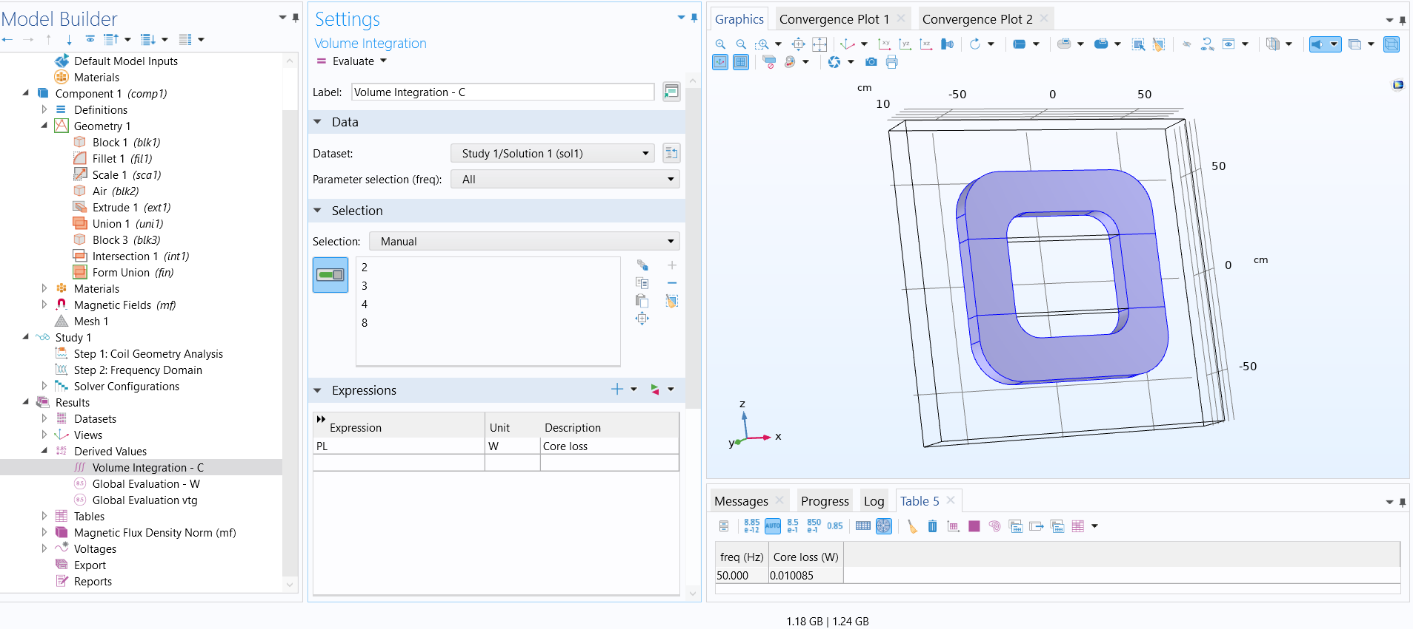
Core loss Calculation

Slide 7
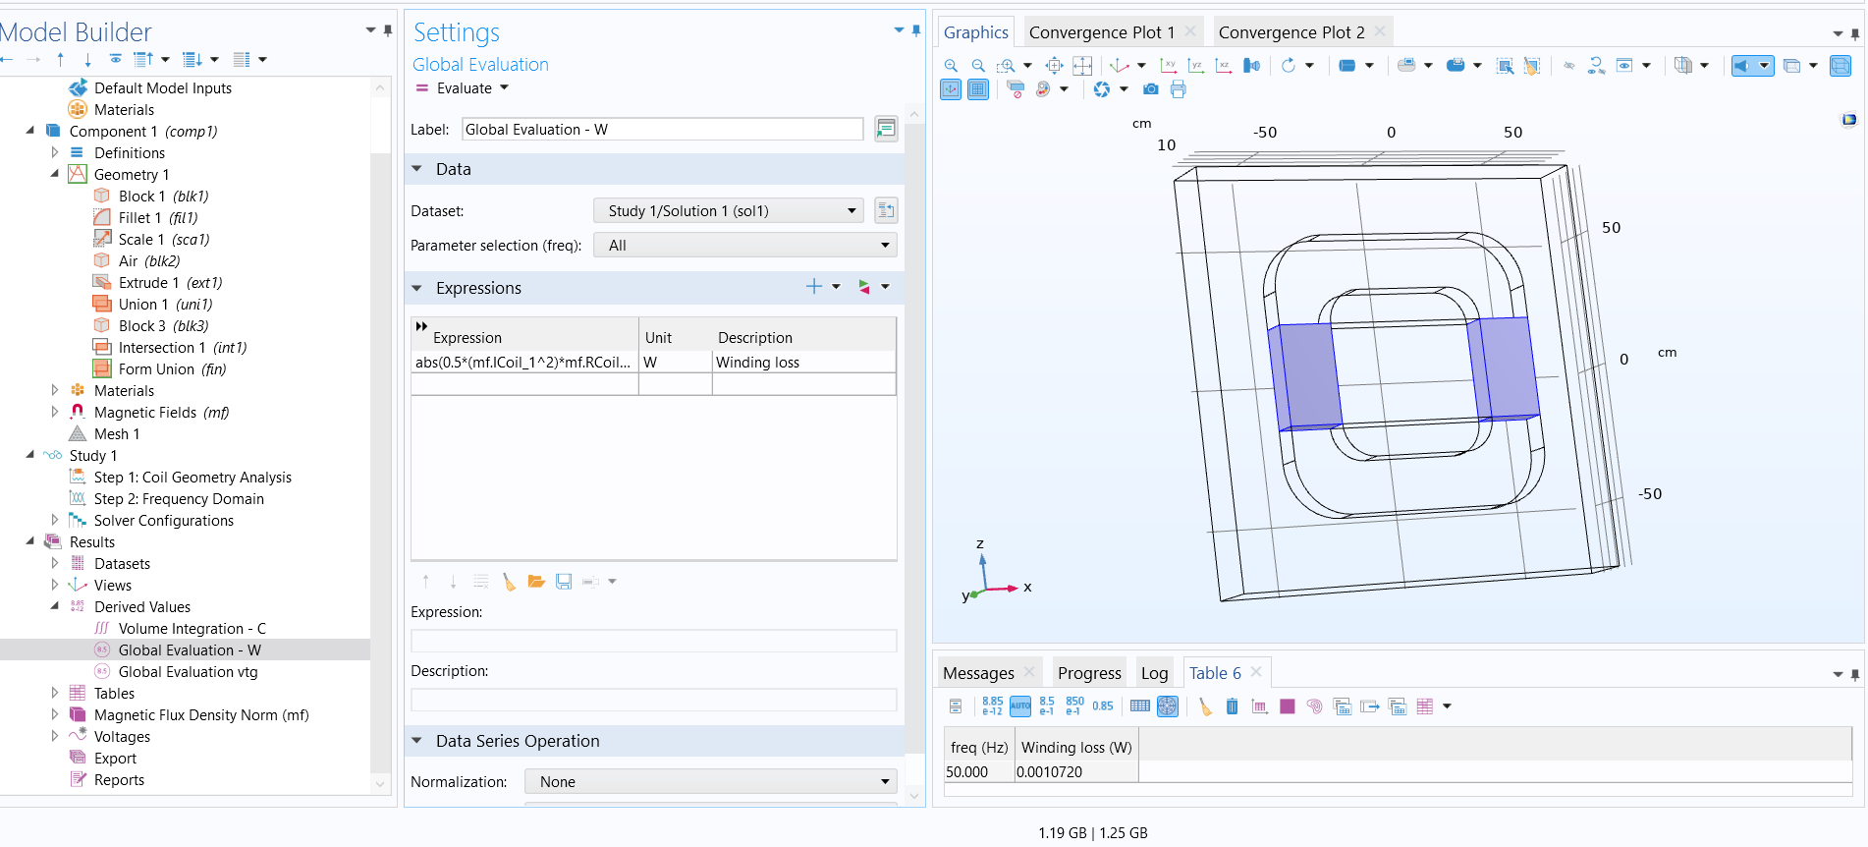
Winding loss calculation
$0.5∗ I^{2} ∗Resistance of coil$ → User Defined

Slide 8
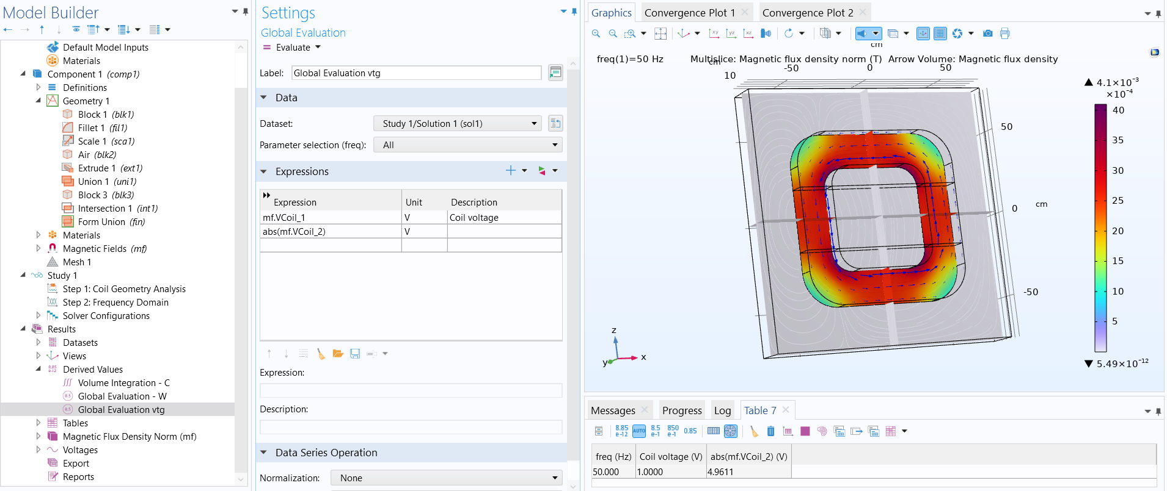
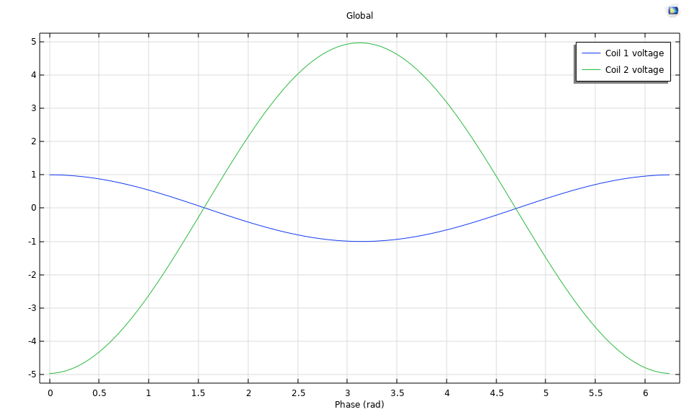
Coil Voltage Calculation

